Slide 1
Potential of Maple as tool for improving financial education of future teachers
Přemysl Rosa and Vladimíra Petrášková, University of South Bohemia, Czech Republic

Slide 2
Overview
Financial literacy in the Czech Republic
Maple
Applications of Maple
Conclusion

Slide 3
Financial literacy
Set of knowledge, skills and propositional attitudes of citizens required to financial secure themself and their families in contemporary society and actively perform on market of financial products and services. Financially literate citizens are familiar with the issue of money and prices and is able to responsibly manage personal/family budget, including the management of financial assets and financial liabilities with respect to changing life situations. (MF CR, 2007)

Slide 4
Financial literacy in czech education system
framework educational programmes
Topic across curriculum
Links between the branches of education Mathematics and its application, Human and society, Human and the world of labour and Computer science and information and communication technologies
In practice, financial education at most secondary schools is still divided into the subjects Mathematics, Essentials of Social Sciences (Civics) and Economics
At primary schools financial education has become mandatory since 2013.

Slide 5
Faculty of Education, University of South Bohemia
Need for financial education of future teachers
Implementation of new technologies
Courses:
Introduction to finance (voluntary)
Basics of Financial Literacy (mandatory)

Slide 6
Maple
CAS software developed by Maplesoft
Curent version: Maple 2016
2 modes
Worksheet mode
Document mode
“smart documents” and maplets
Maple Player

Slide 7
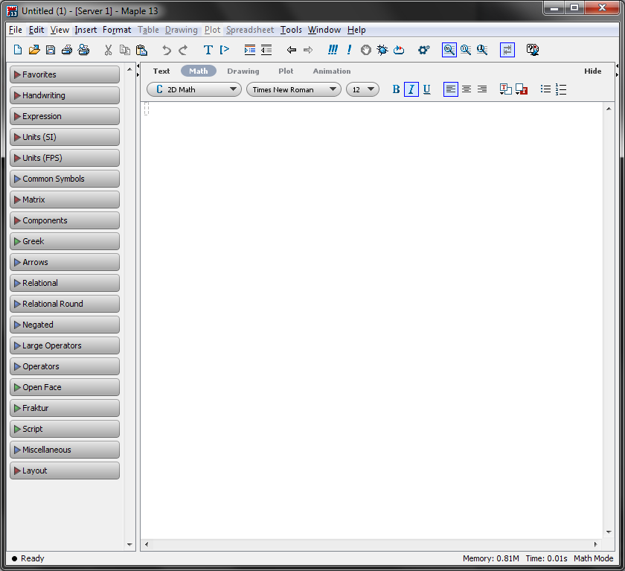
Maple 13 GUI

Slide 8
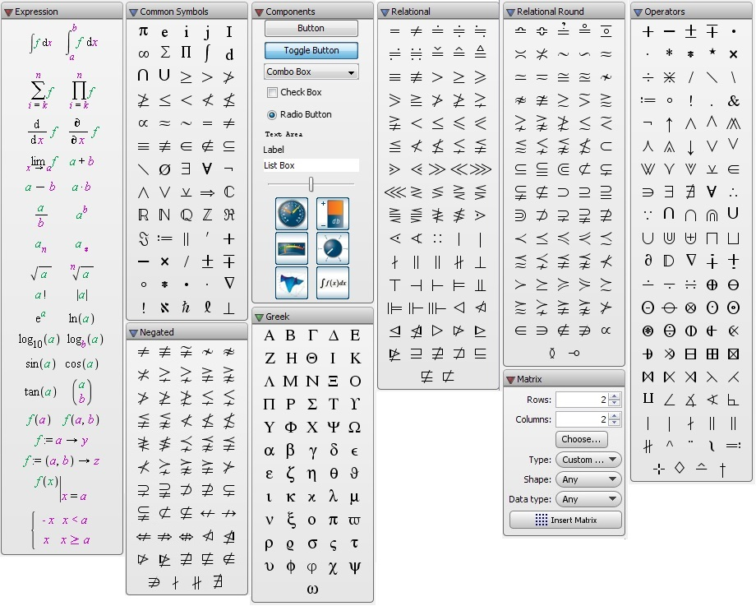
Palettes

Slide 9
Applications of Maple

Slide 10
Conclusion
Disadvantages
Price of Maple (1500 USD)
Maple player doesn‘t support maplets
Advantages
User-friendly interface
Interactivity
Maple player
Verified benefit (Hašek and Petrášková, 2014)
Applicability in other fields

Slide 11
References
Hašek, R., & Petrášková, V. (2014). Effective methods of teaching financial issues. In Proceedings of the 11th International Conference Efficeency and Responsibility in Education (ERIE 2014). Praha, pp. 186-192.
MF ČR (2007). Strategie finančního vzdělávání [online]. Praha: Ministerstvo financí ČR. Available: http://www.mfcr.cz [4 September 2016]

Slide 12
Thank you for your attention

